Slide 1
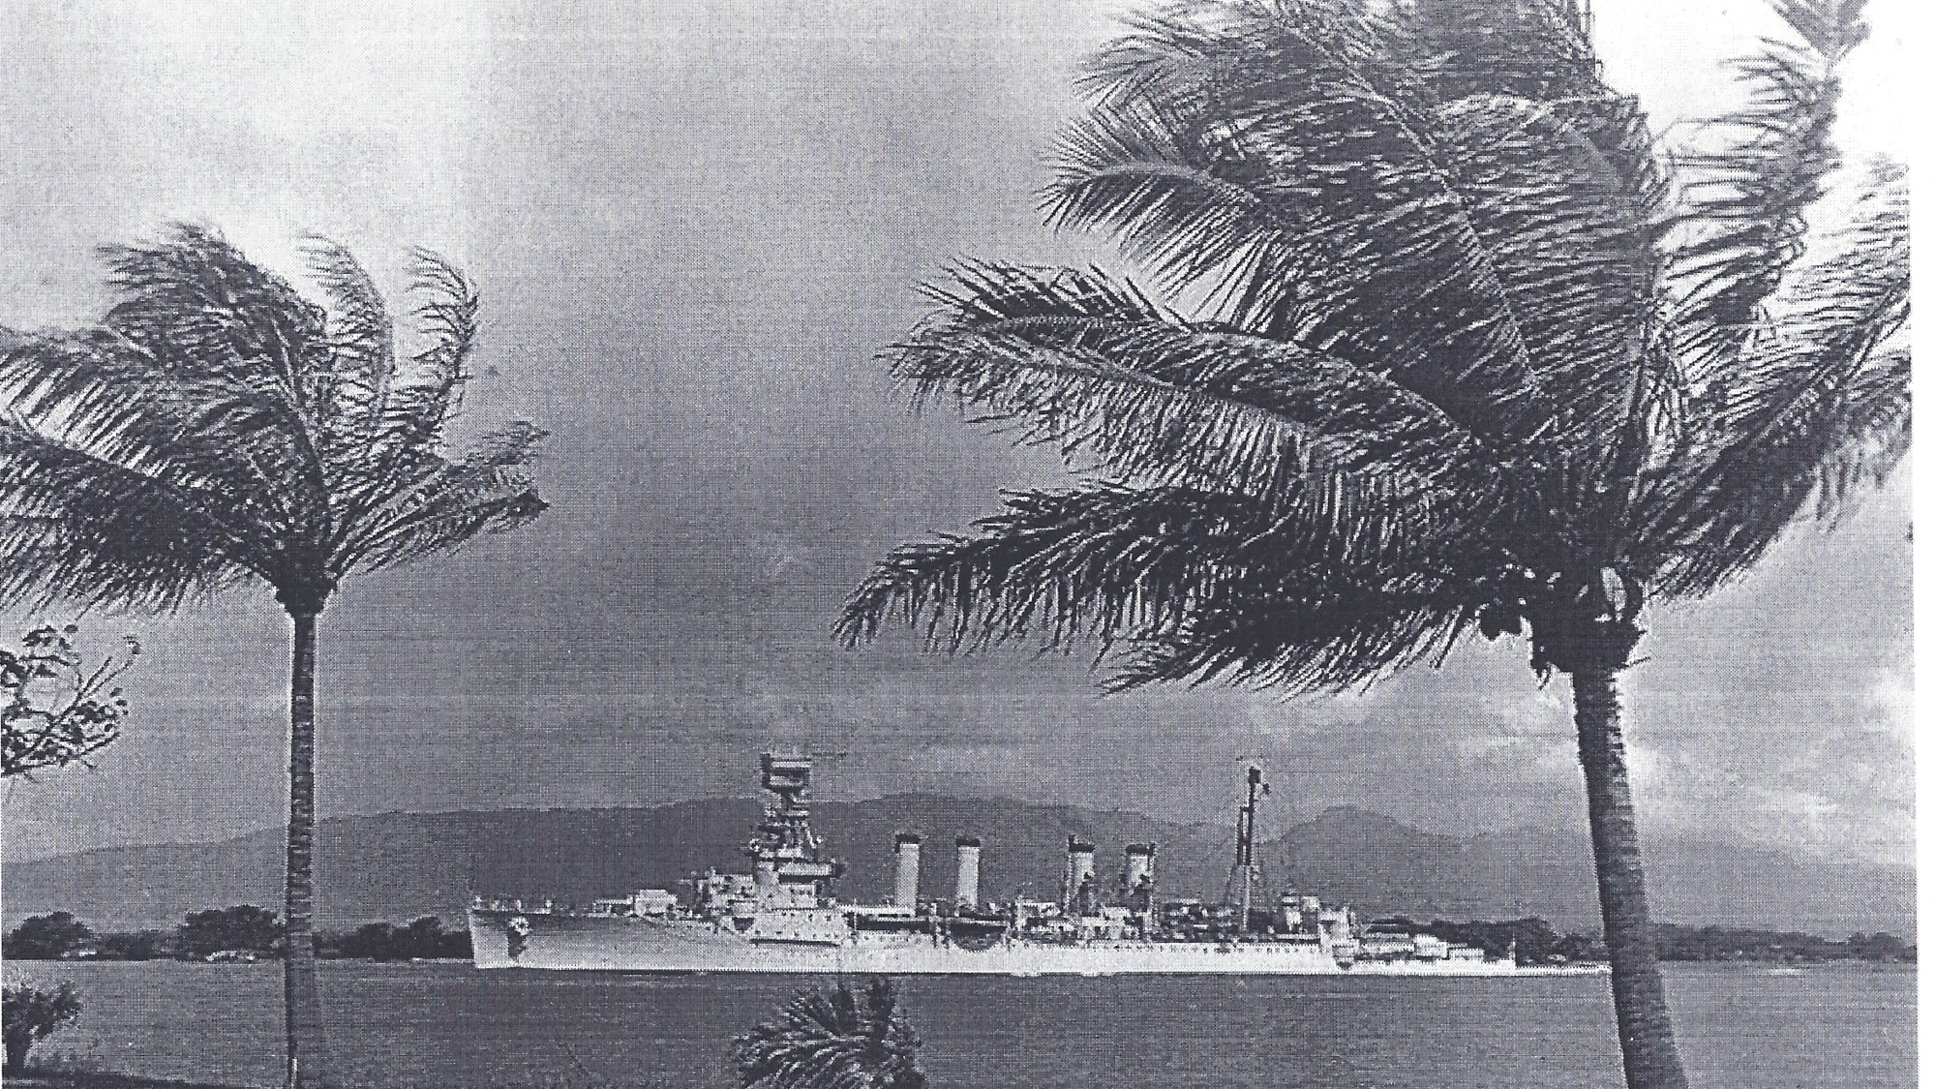
THE USS MILWAUKEE WAS IN HONOLULU CHRISTMAS 1923

Slide 2
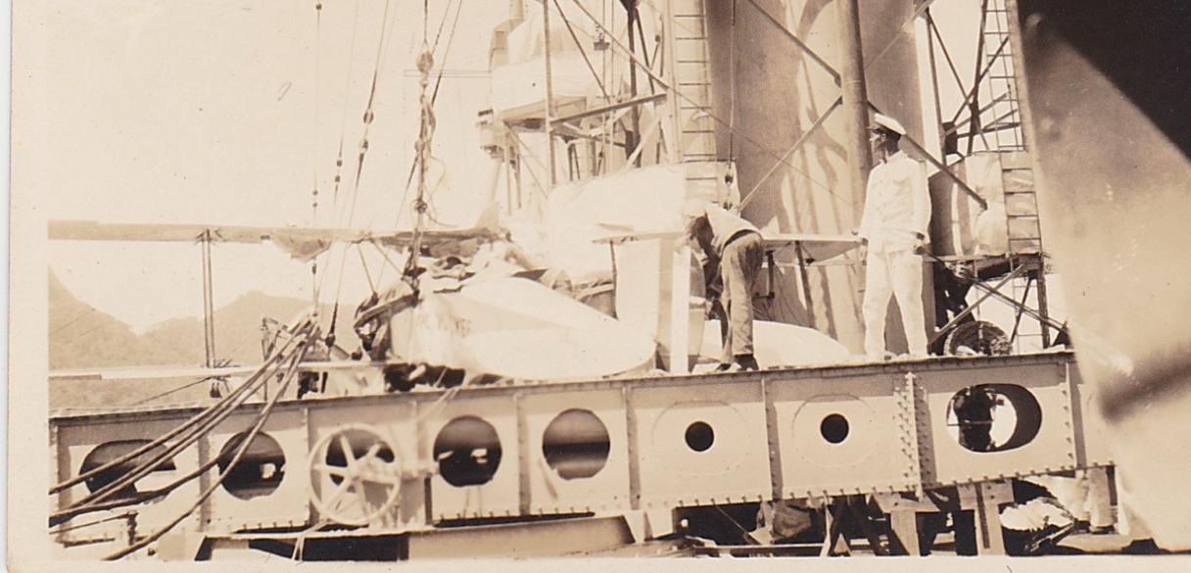
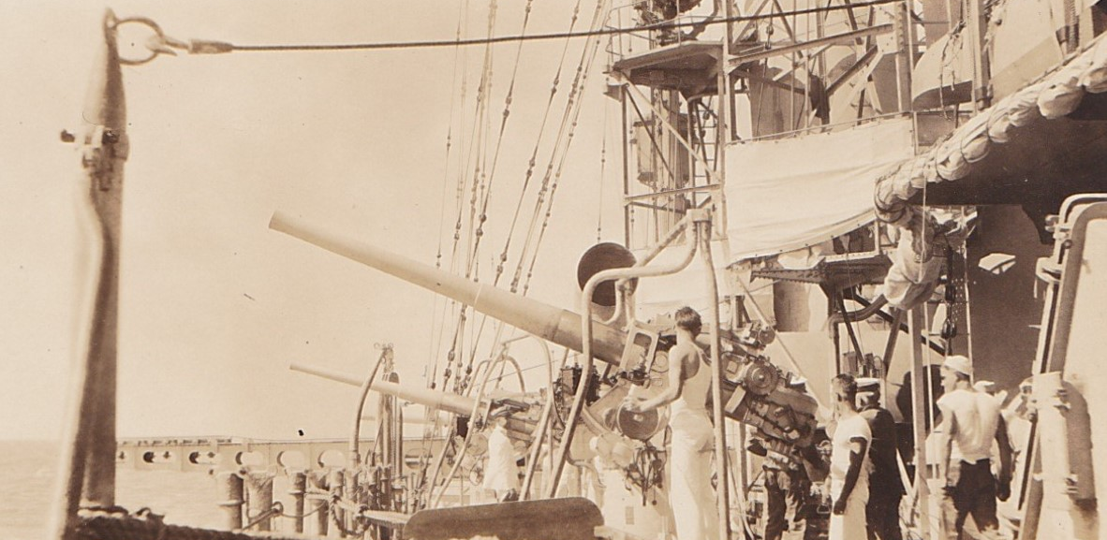
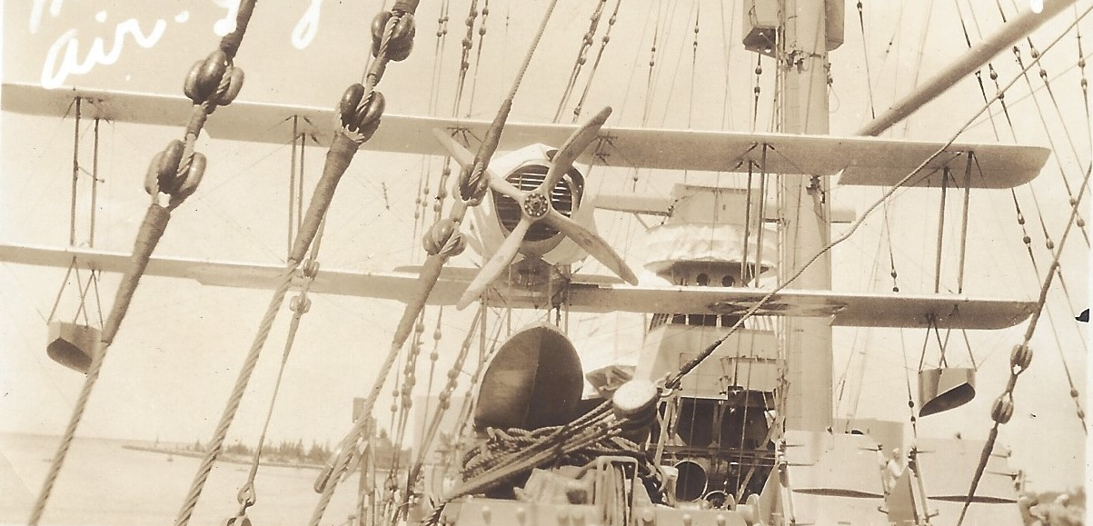
USS MILWAUKEE SAILED FROM HAWAII TO HONDURAS EARLY 1924

Slide 3
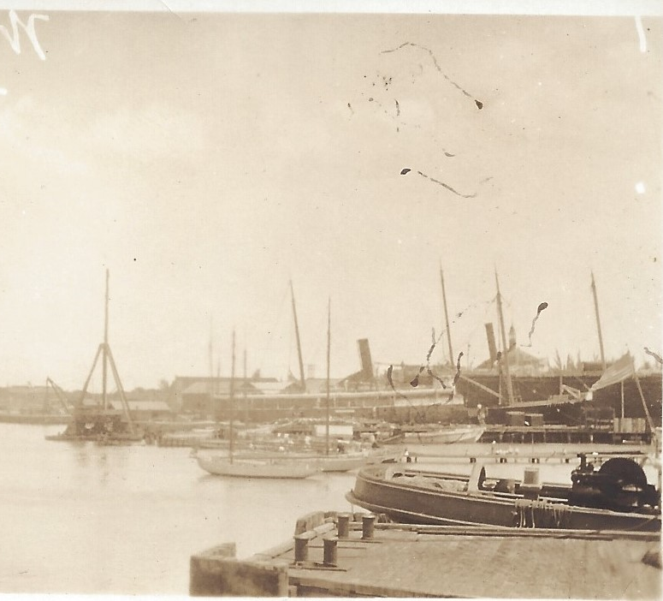
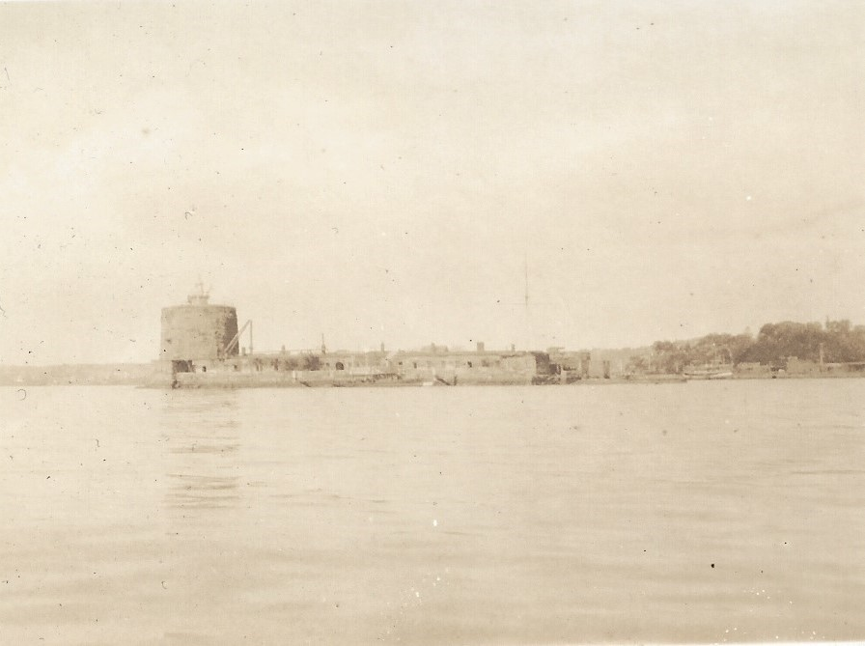
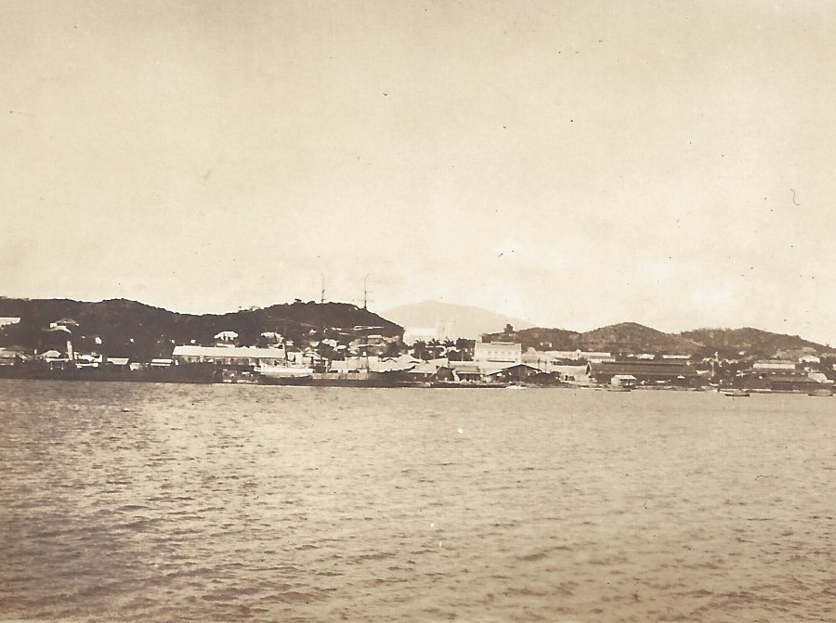
MAINLAND NEAR AMAPALA PORT, ISLA EL TIGRE ON PACIFIC SIDE OF HONDURAS

Slide 4
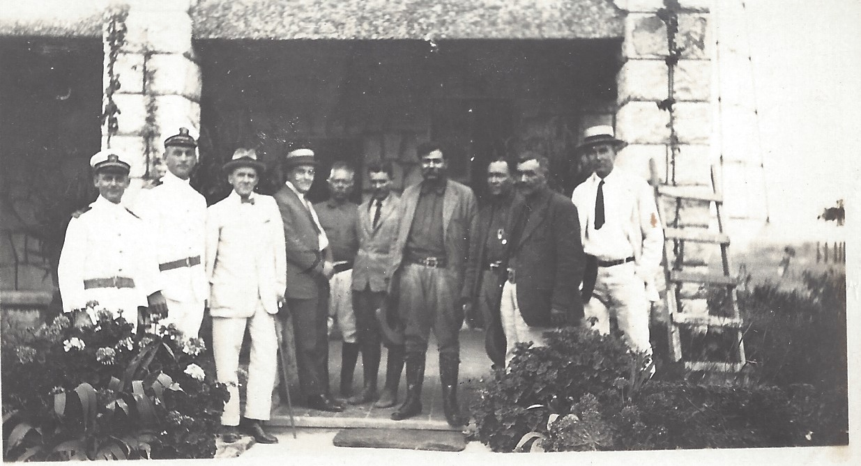
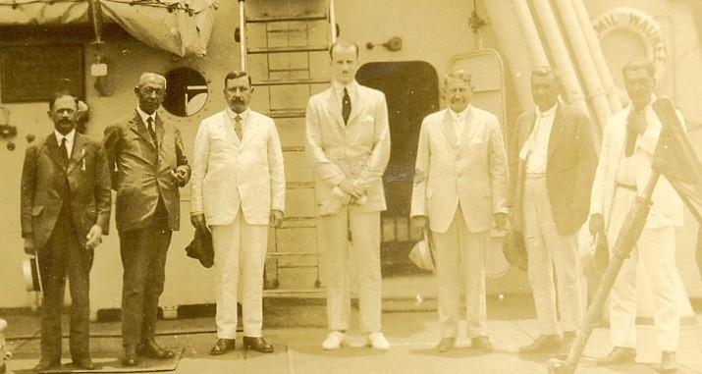
DIPLOMATIC ATTEMPTS WERE UNDERTAKEN TO SOLVE THE HONDURAN GOVERNMENT ISSUES

Slide 5
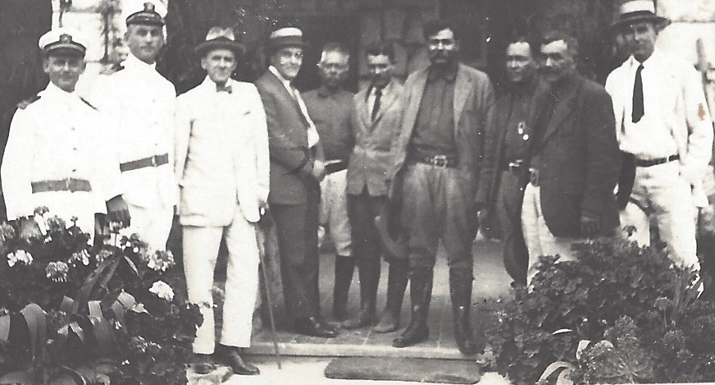
Left to right: Cannot identify the two U.S. naval officers in white, nor the gentleman in the bow tie
Franklin Morales, U.S. Ambassador to Honduras from Jan 1922 to April 1925.
Honduran military chiefs that your father probably saw:
General Francisco Martinez, a National Party military chieftain;
To his right, General Vicente Tosta, provisional president of Honduras between late 1924 and early 1925;
to his right, General Tiburcio Carias Andino, National Party president of Honduras and longtime dictator between 1933 and early 1949;
to his right, Antonio C. Rivera, Caria’s representative on the USS Milwaukee;
to his right, I am convinced, is Francisco Lopez Padilla, Rafael Lopez Padilla’s brother. As you might recall, I am writing a biography of Rafael Lopez Padilla.
I cannot identify the man to Lopez Padilla’s right, in the white suite and black tie….
(Email from Dario Euraque, dated 4 May 2021)

Slide 6

Left to right:
1
2
3
4 Sumner Welles
5
6
7

Slide 7
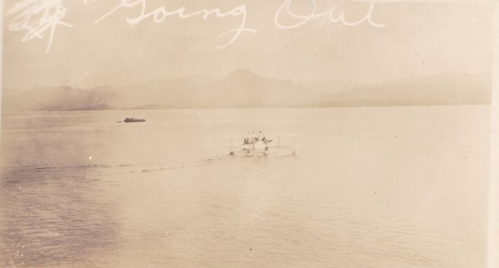
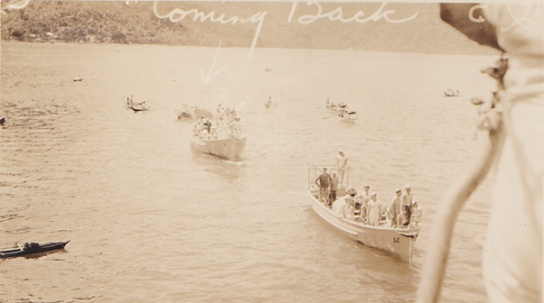
USS MILWAUKEE SAILORS LANDING party that will MOVE UP TO TEGUCIGALPA
Coming Back
Going Out

Slide 8
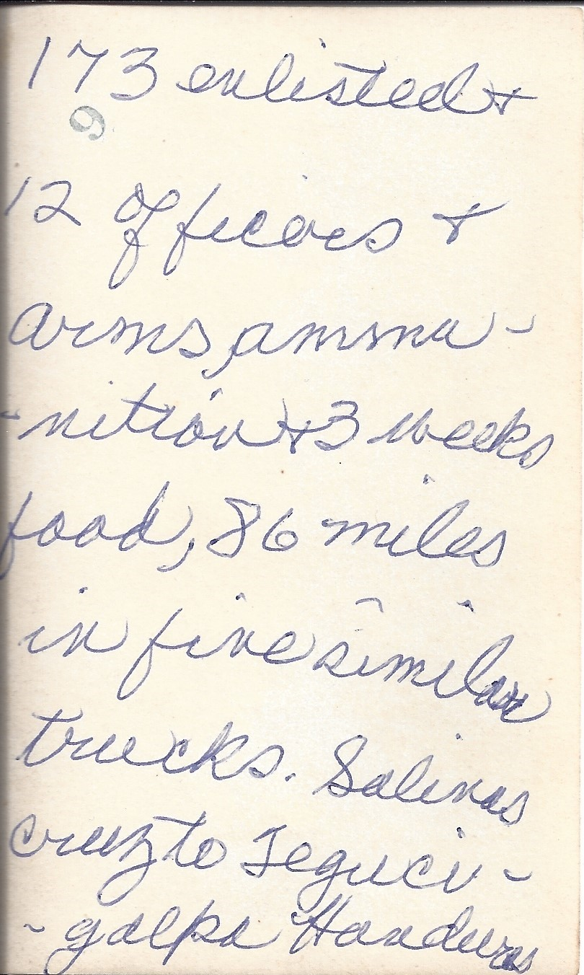
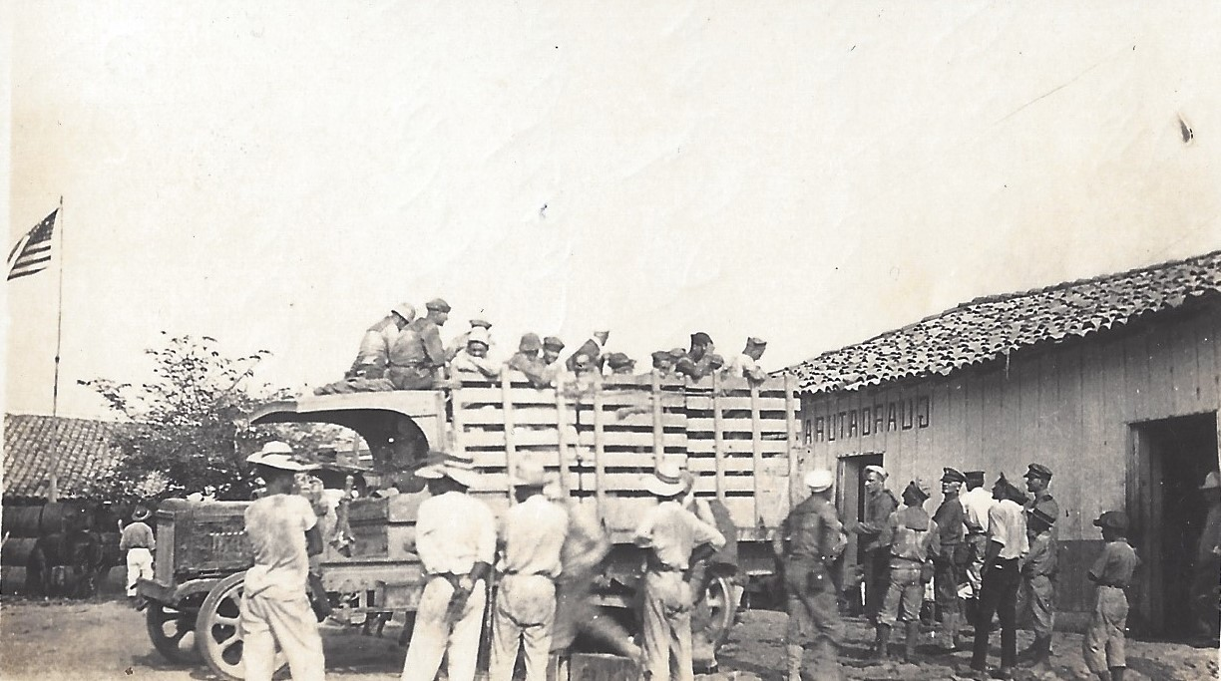
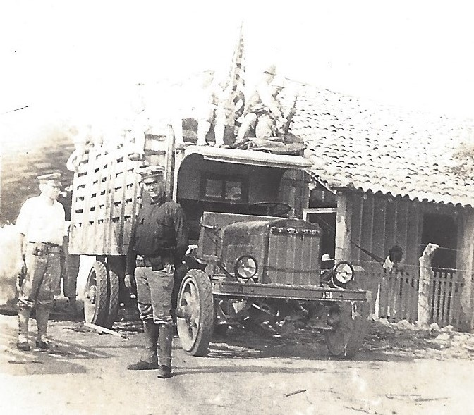
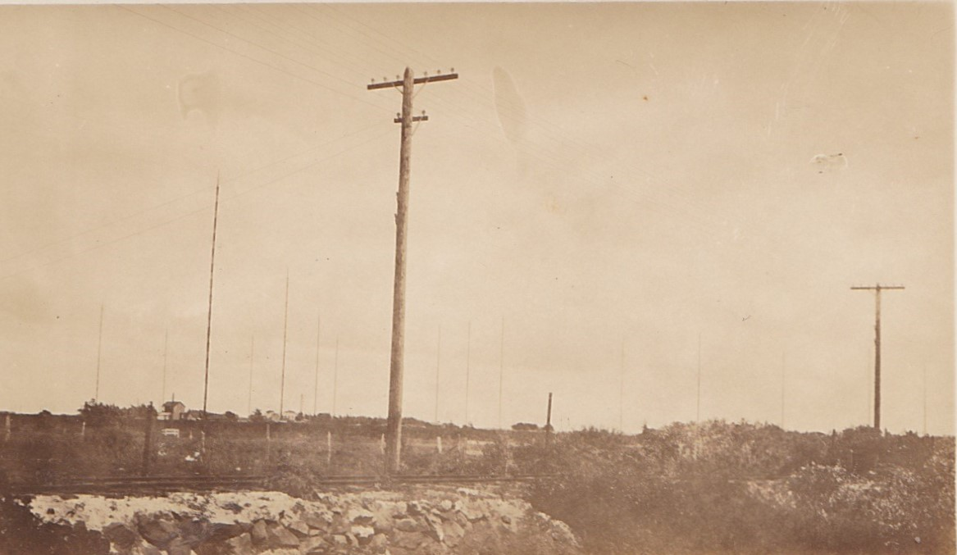
USS MILWAUKEE SAILORS LOADING UP FOR THE RIDE TO TEGUCIGALPA; RAILROAD & TELEGRAPH

Slide 9
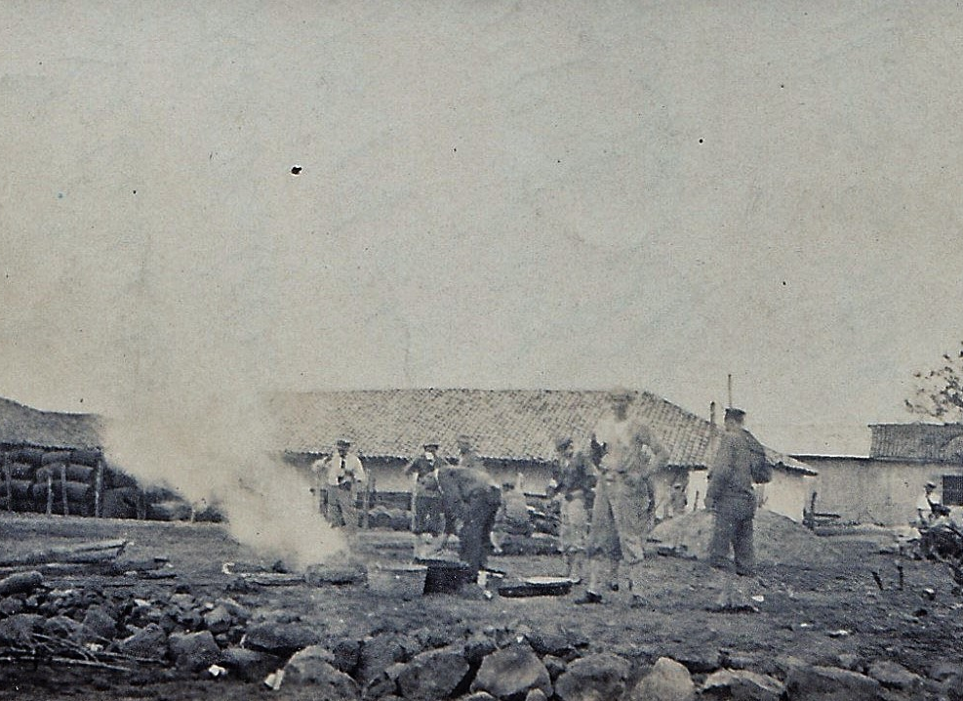
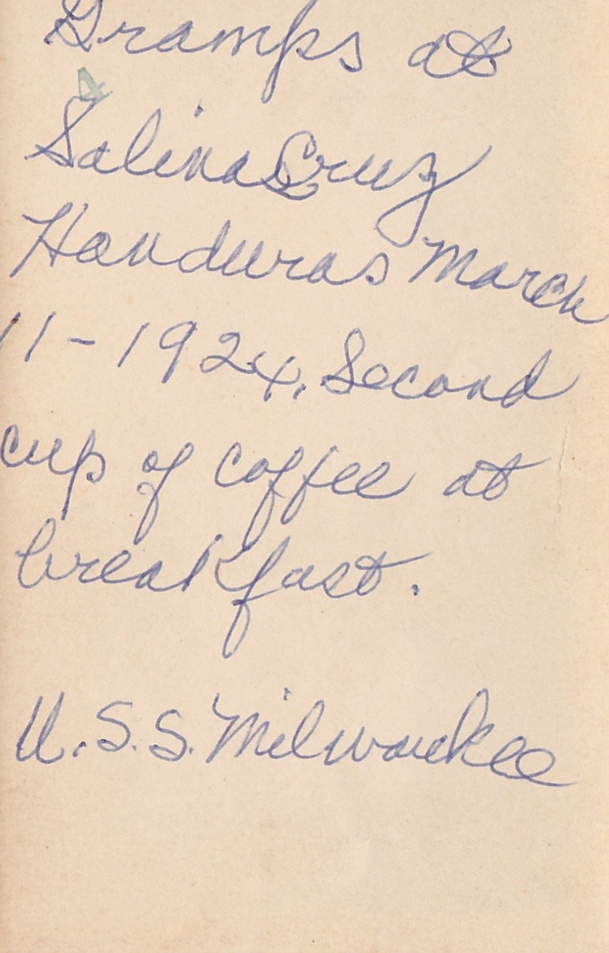
DADDY (WILLIAM BURTON HARRISON, SR.) HAVING SECOND CUP OF COFFEE AT SALINAS CRUZ CAMPGROUND

Slide 10
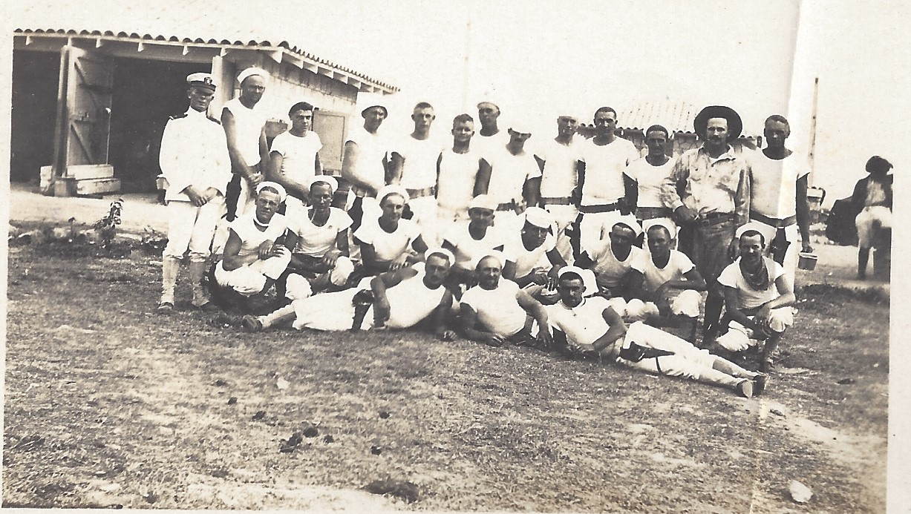
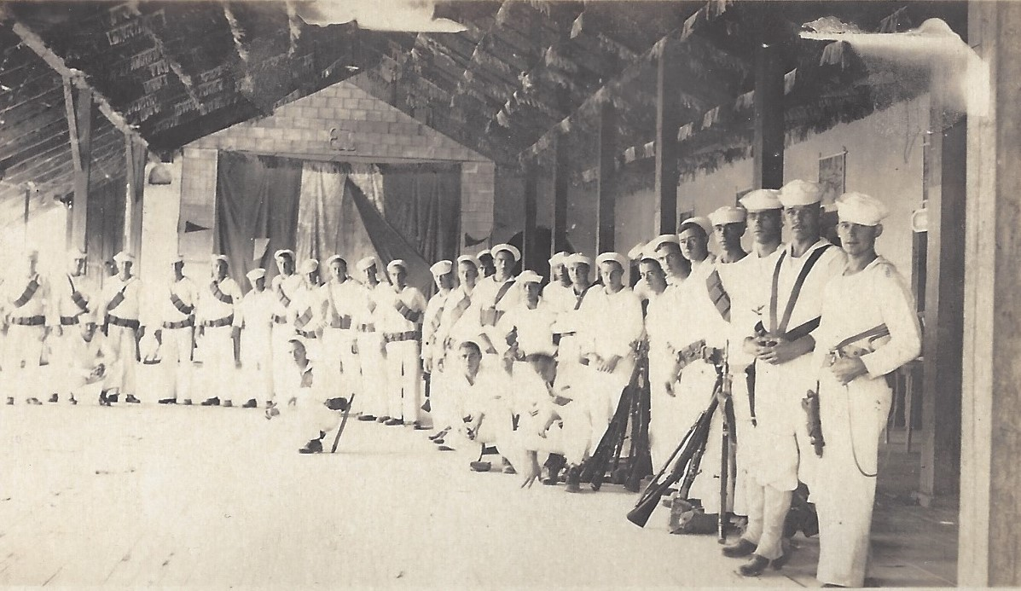
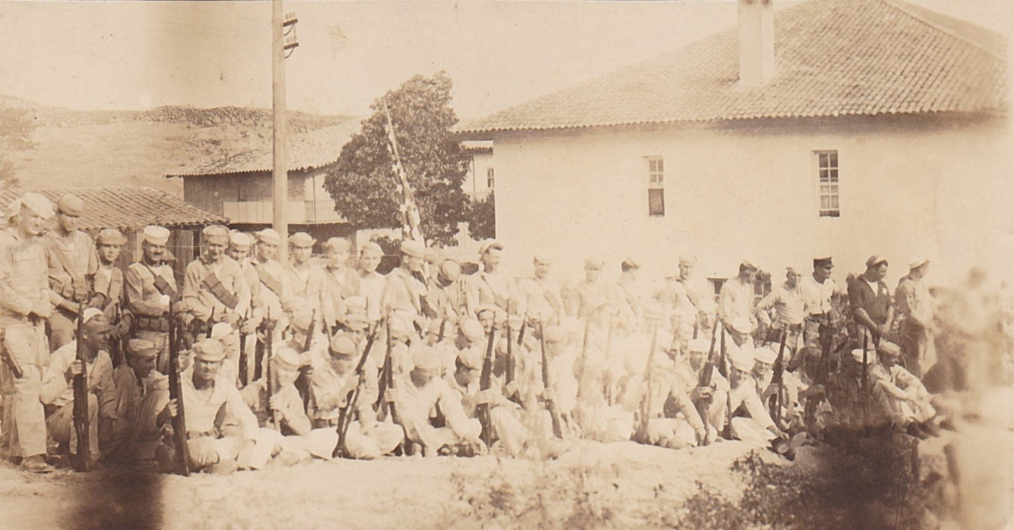
TROOPS GATHERING FOR ACTION TO SUPPORT HONDURAS OFFICIALS AGAINST REVOLUTIONARIES

Slide 11
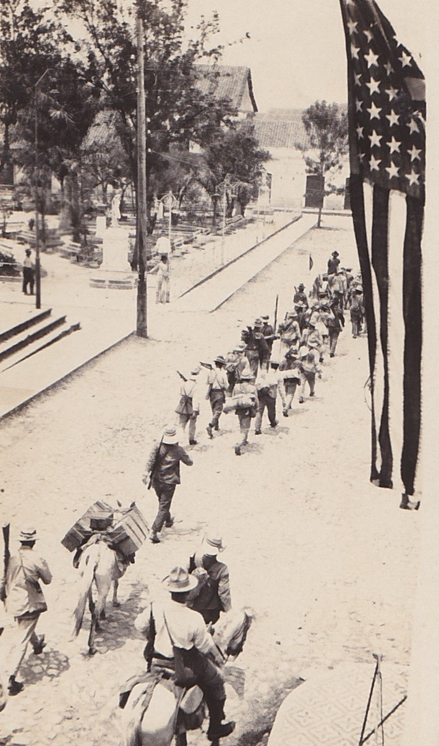
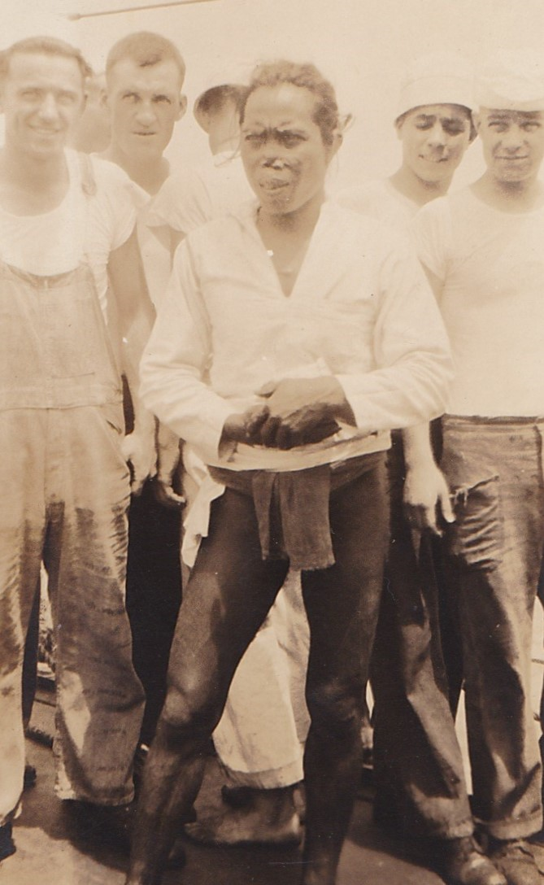
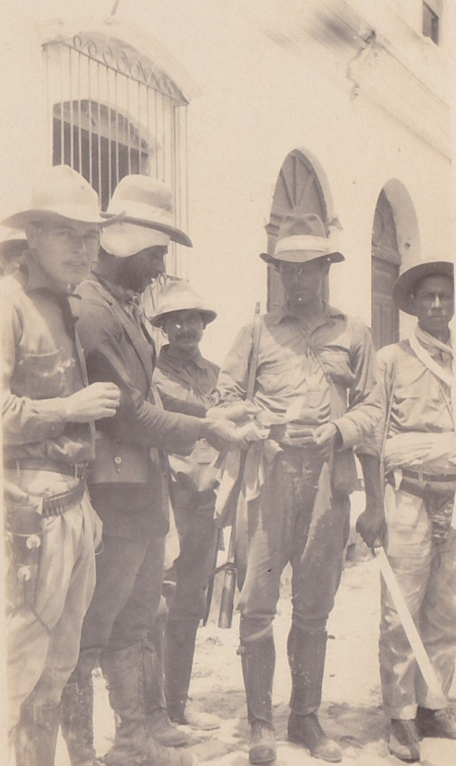
US TROOPS WITH LOCAL MILITIA AND A SHOW OF FORCE -MARCHING PAST US EMBASSY AND PARQUE CENTRAL

Slide 12
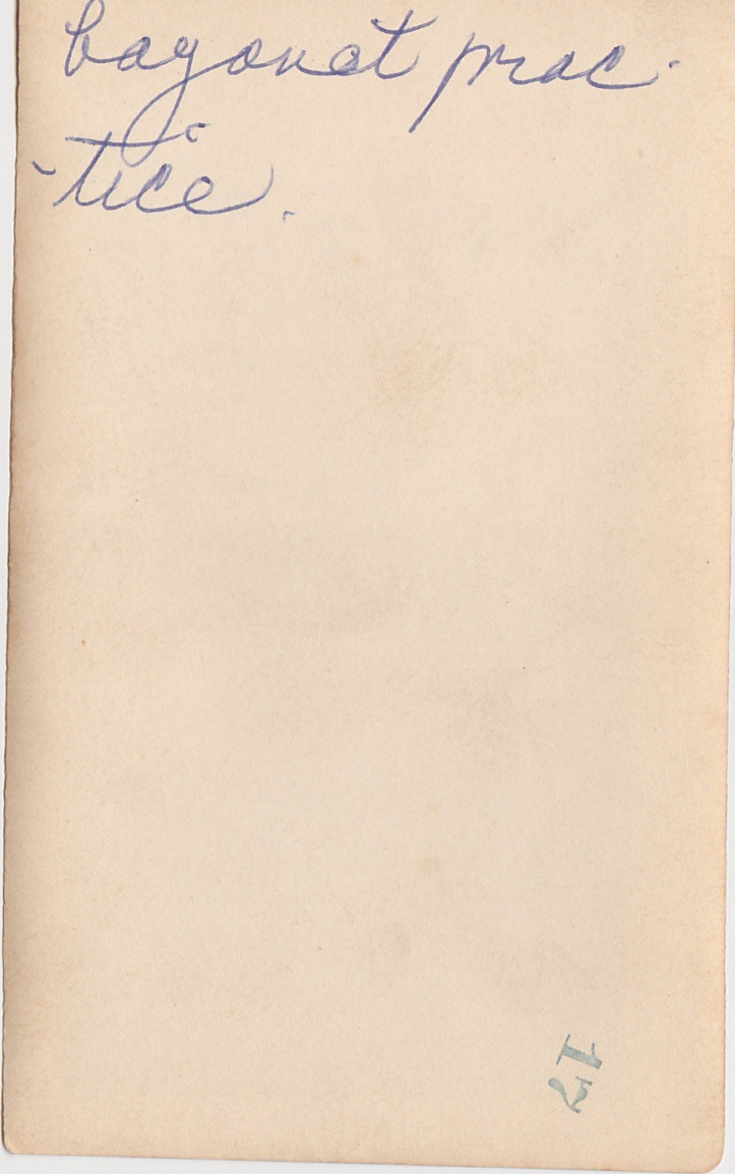
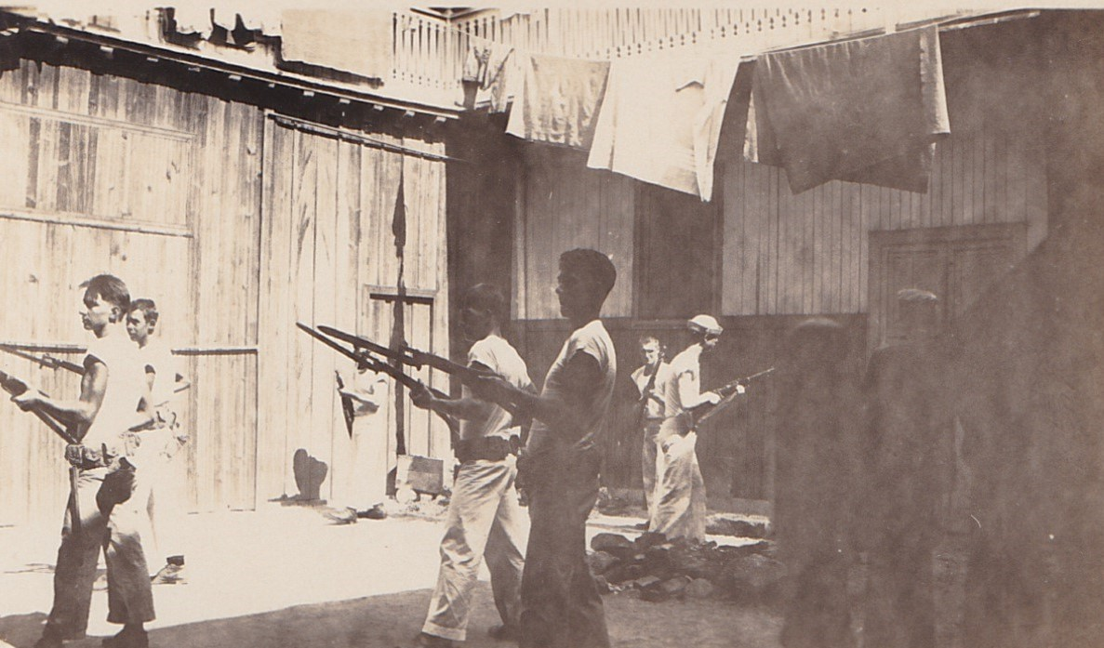
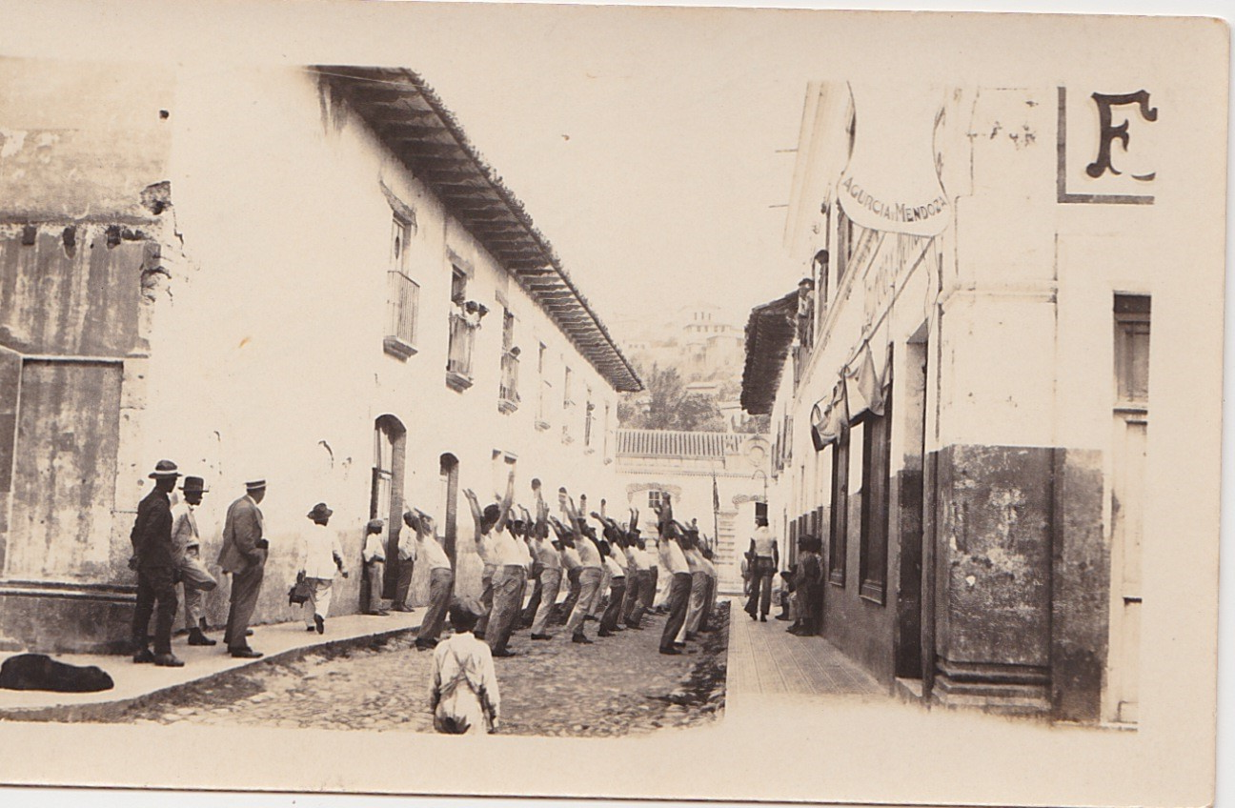
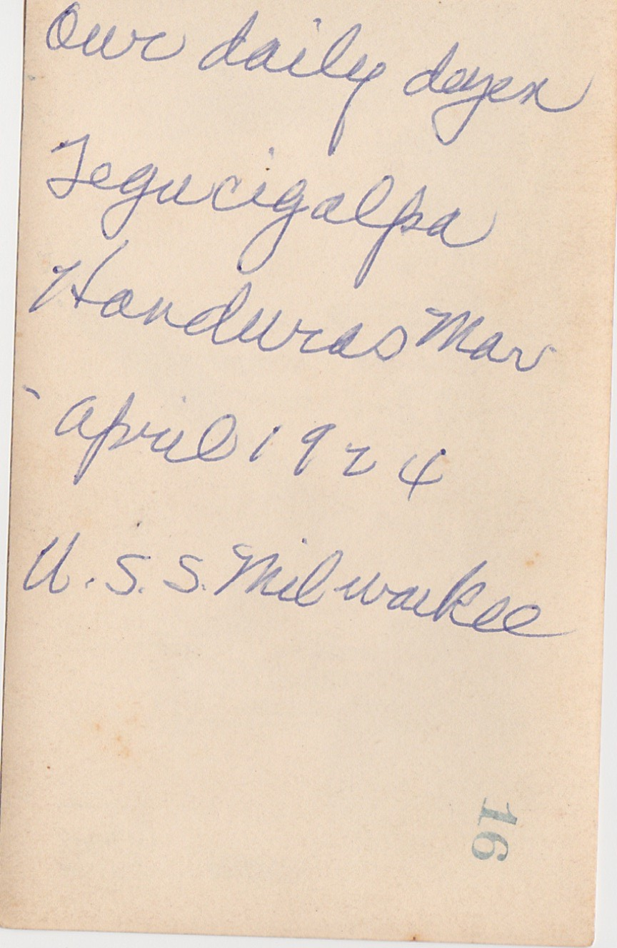
US TROOPS WITH LOCAL MILITIA EXERCISING AND BAYONET TRAINING

Slide 13
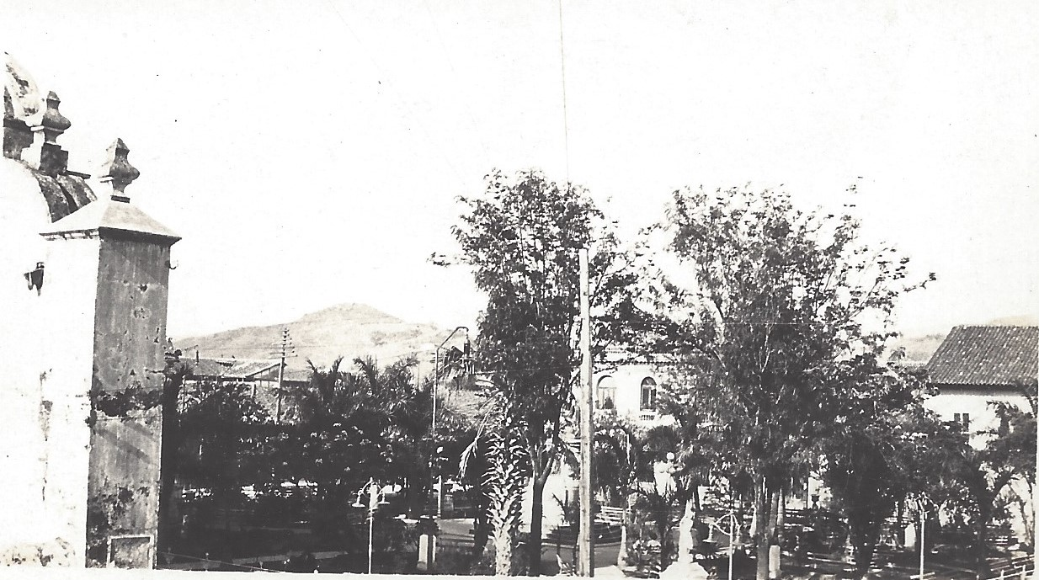
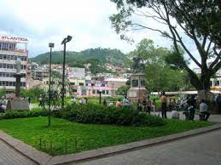
PARQUE CENTRAL THEN AND NOW

Slide 14
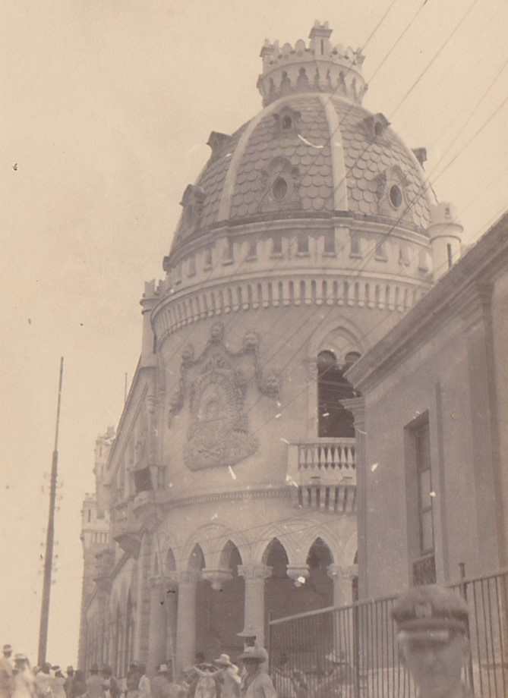
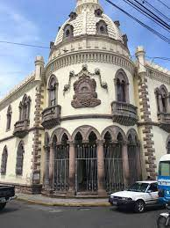
ANTIGUA CASA PresidenCial NOW AND then

Slide 15
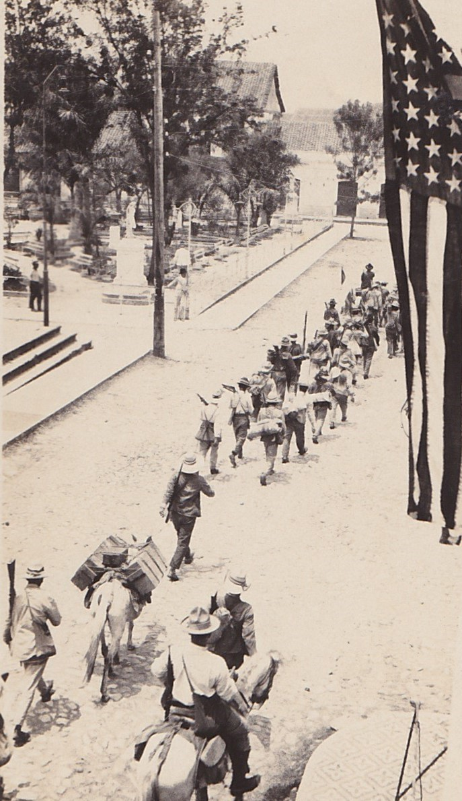
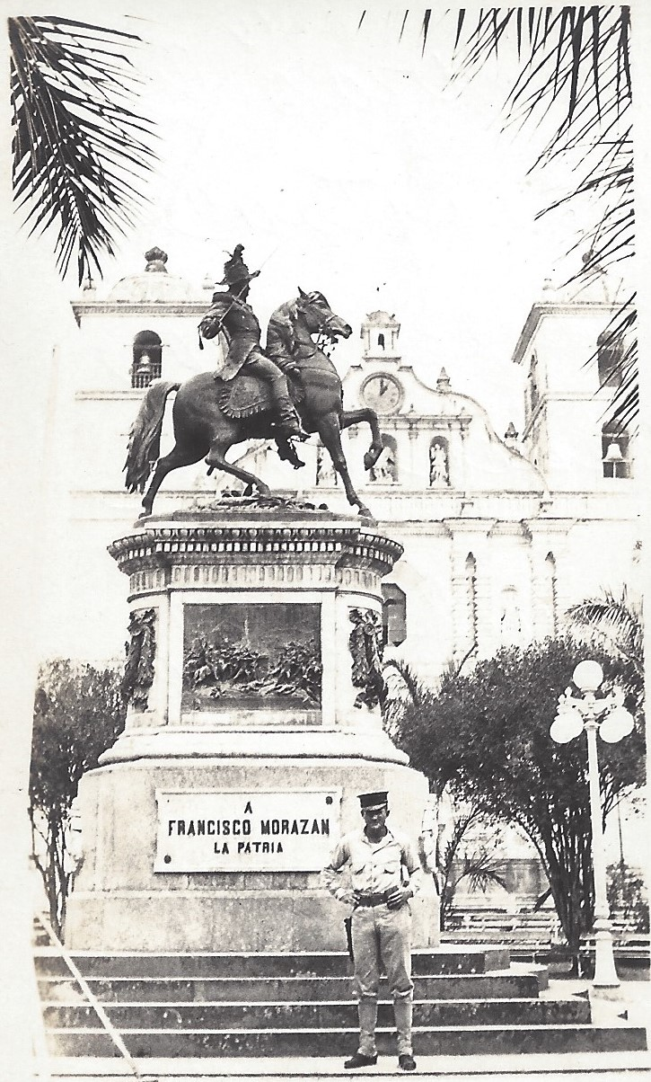
PARQUE CENTRAL

Slide 16
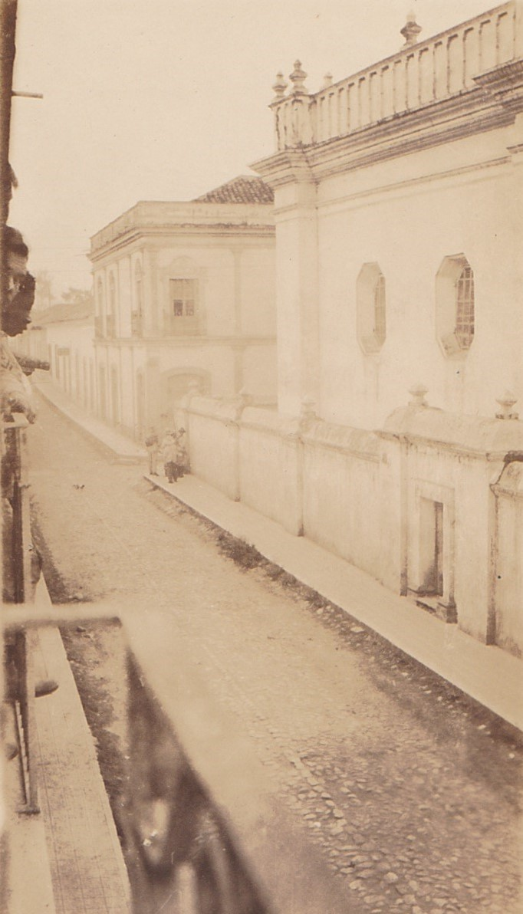
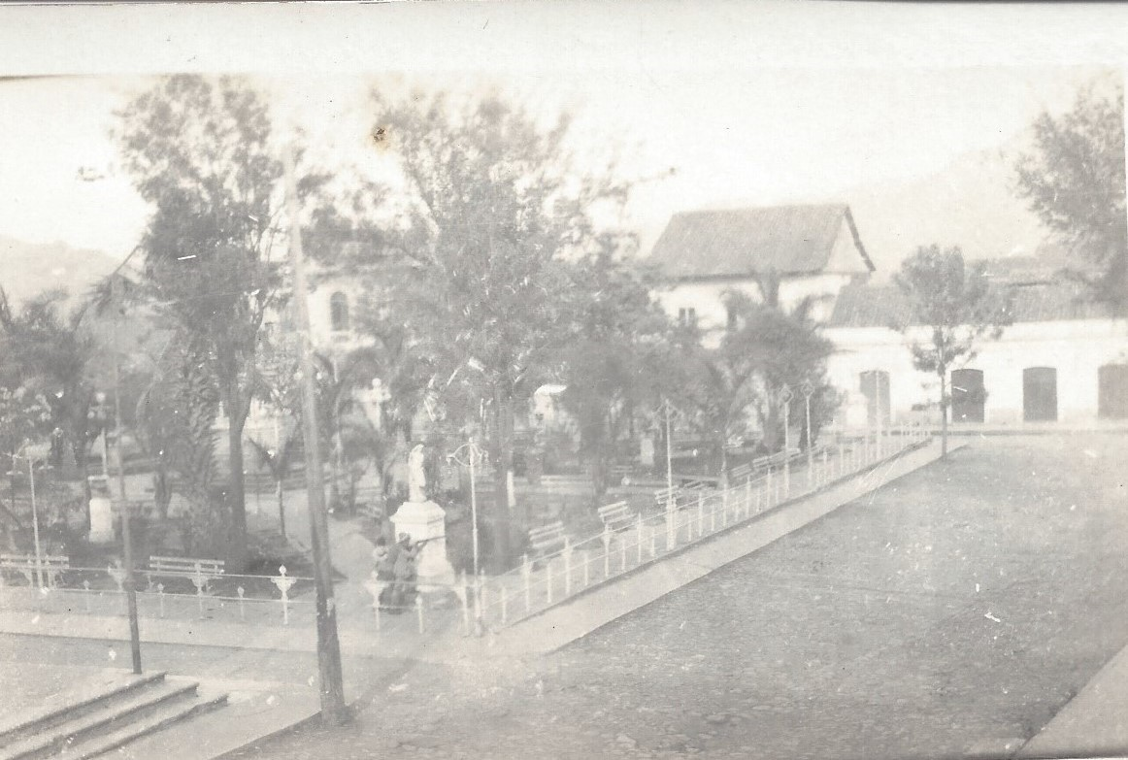
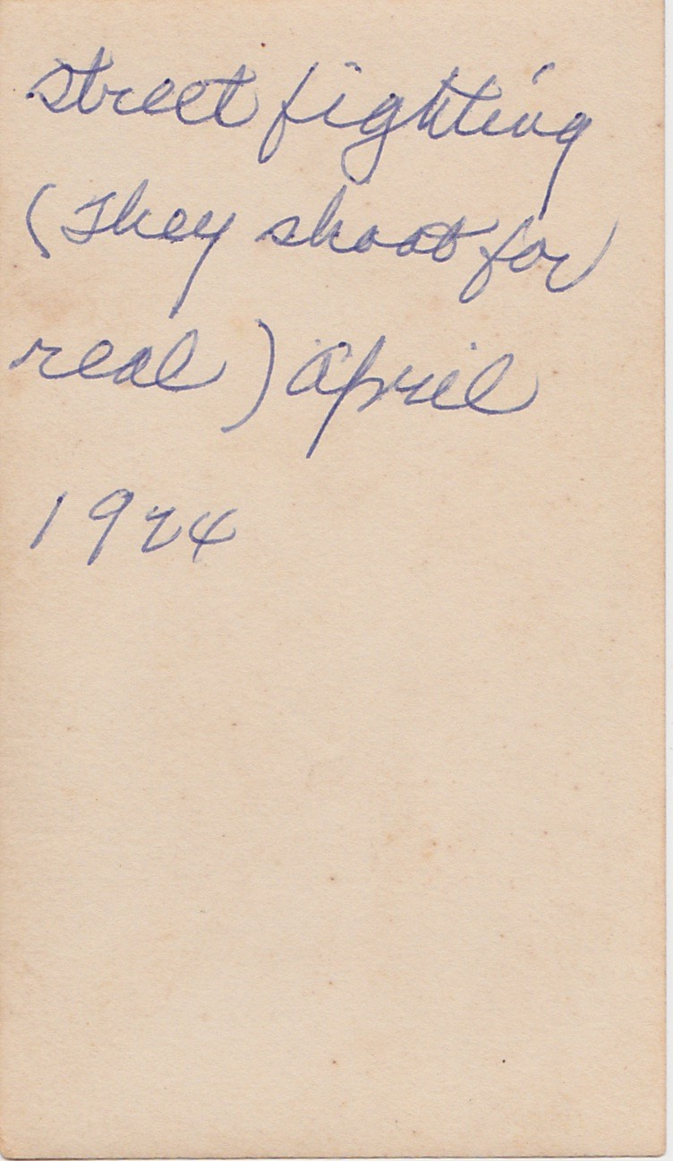
STREET FIGHTING AND SNIPER at PARQUE CENTRAL

Slide 17
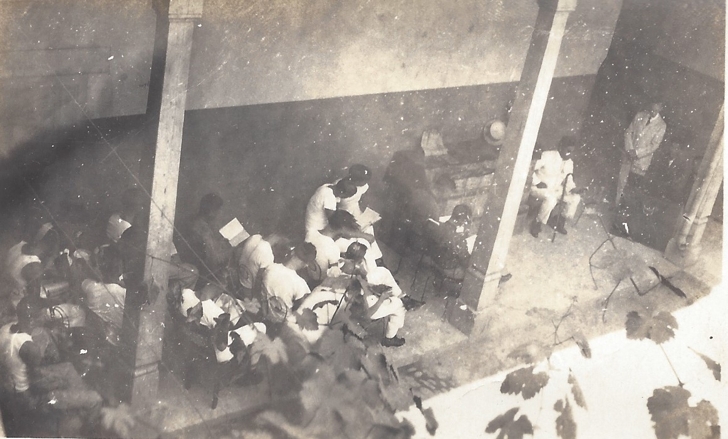
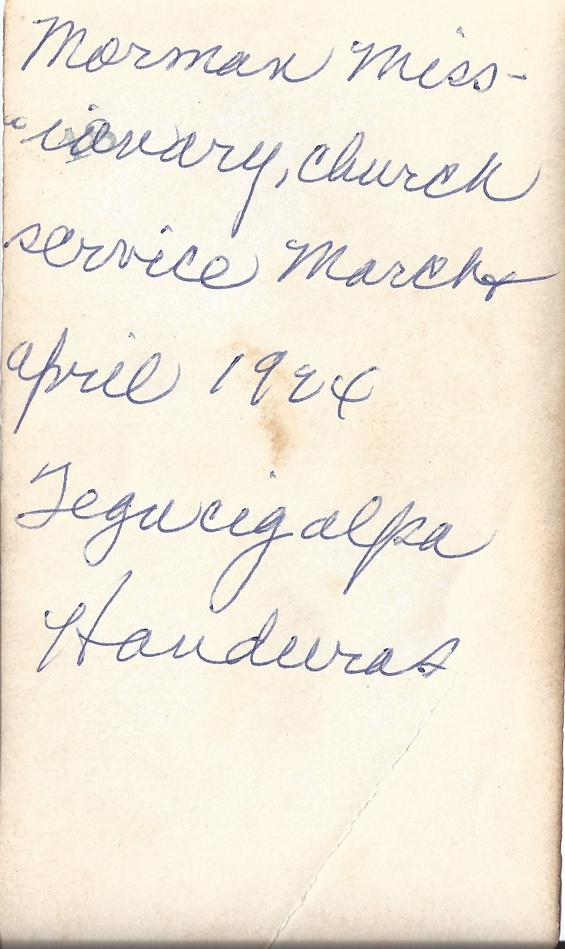
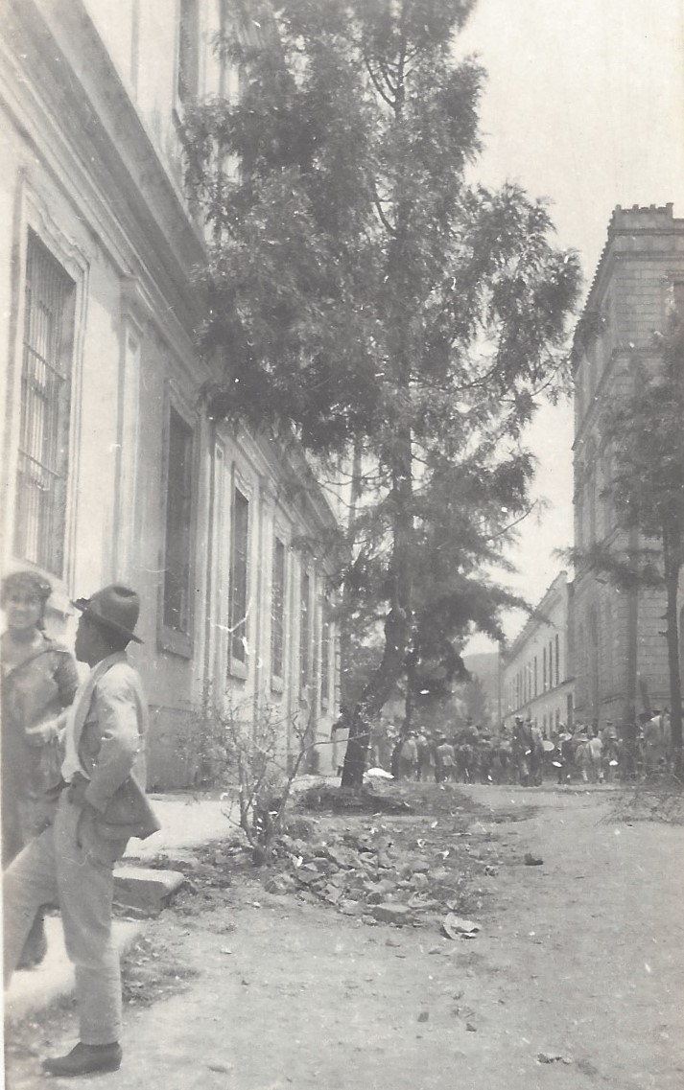
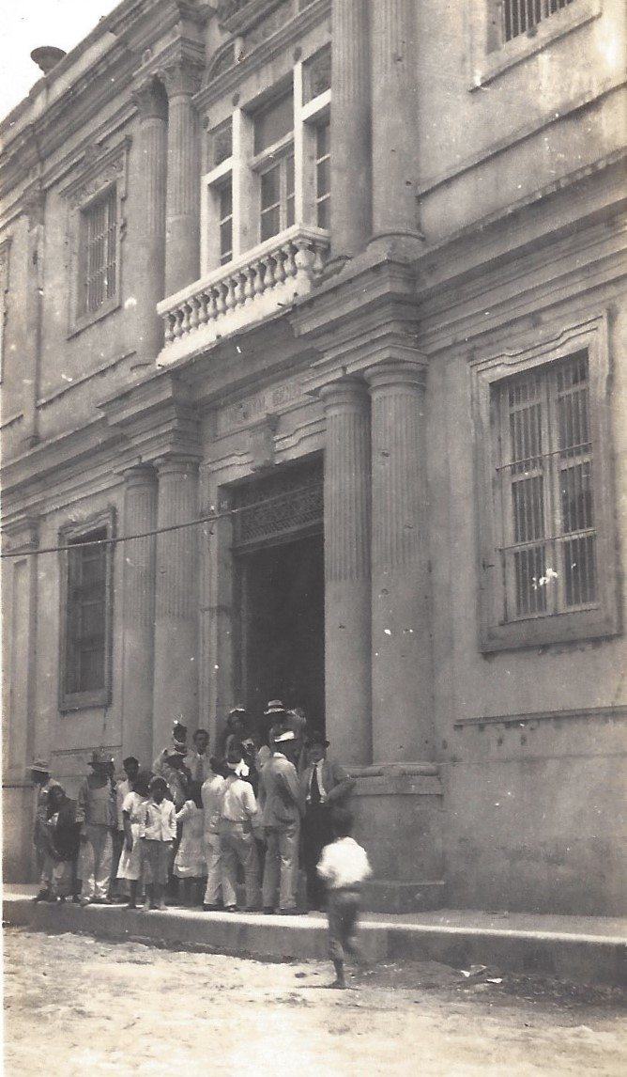
TEGUCIGALPA STREET SCENES

Slide 18
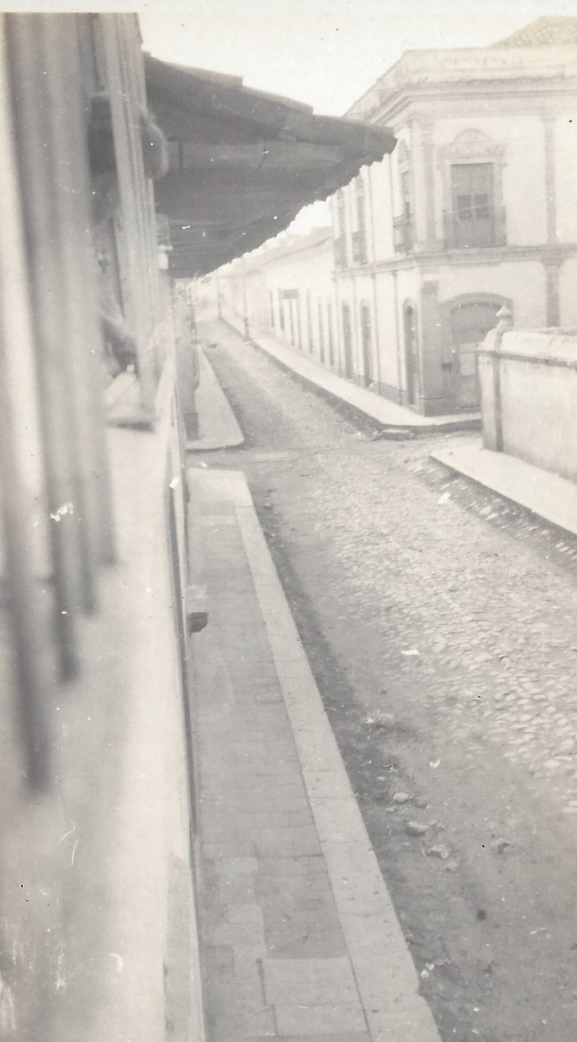
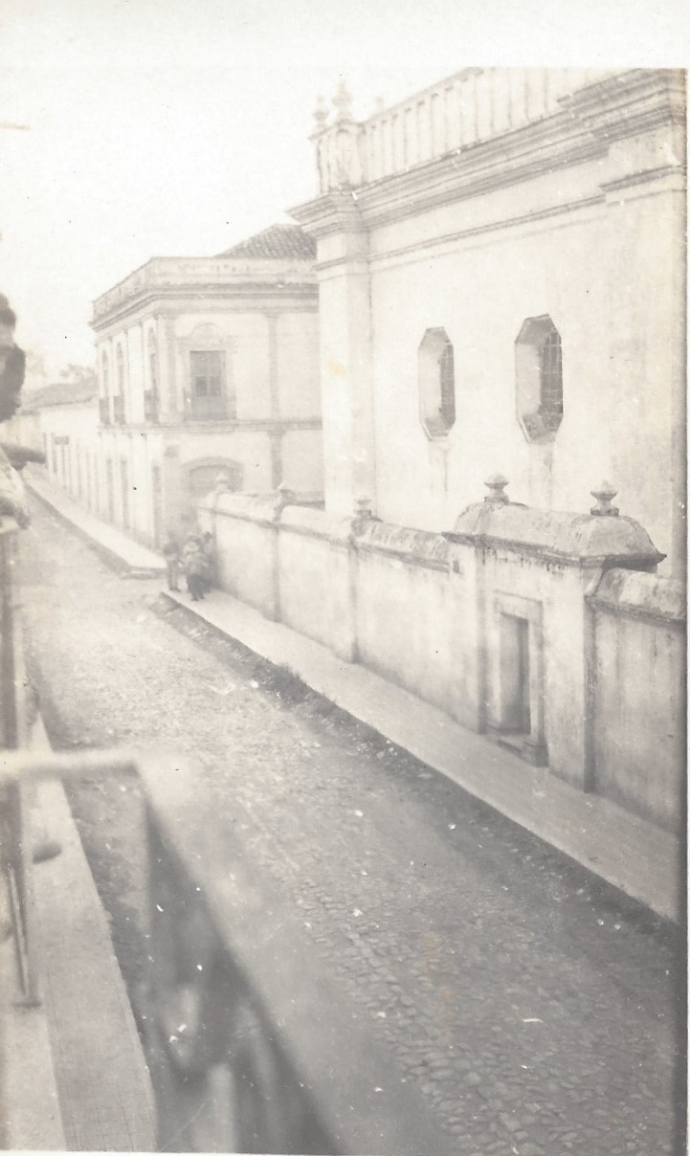
TEGUCIGALPA STREET SCENES

Slide 19
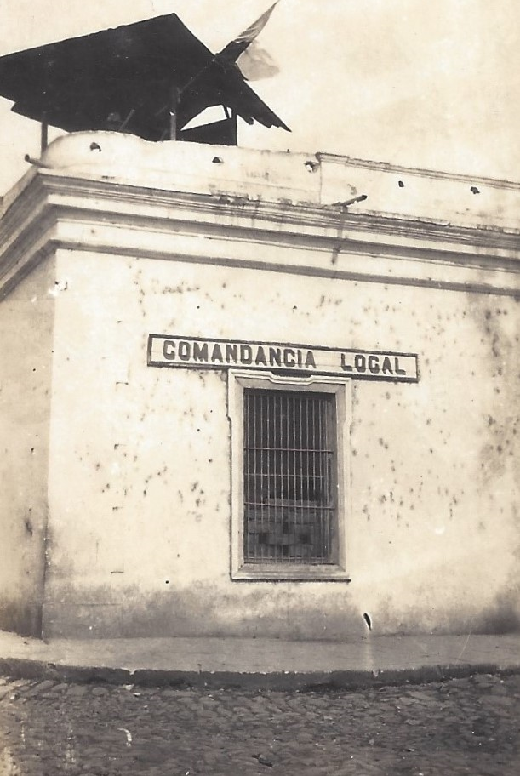
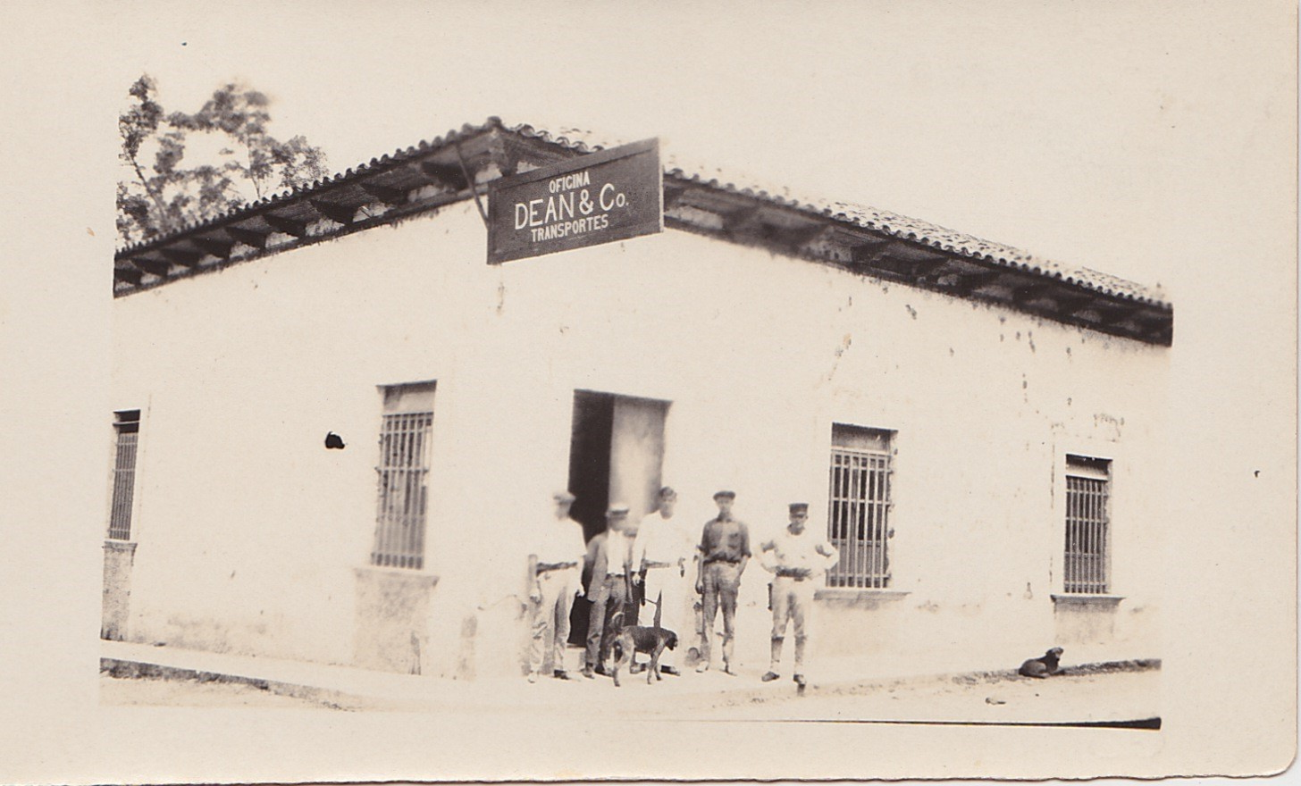
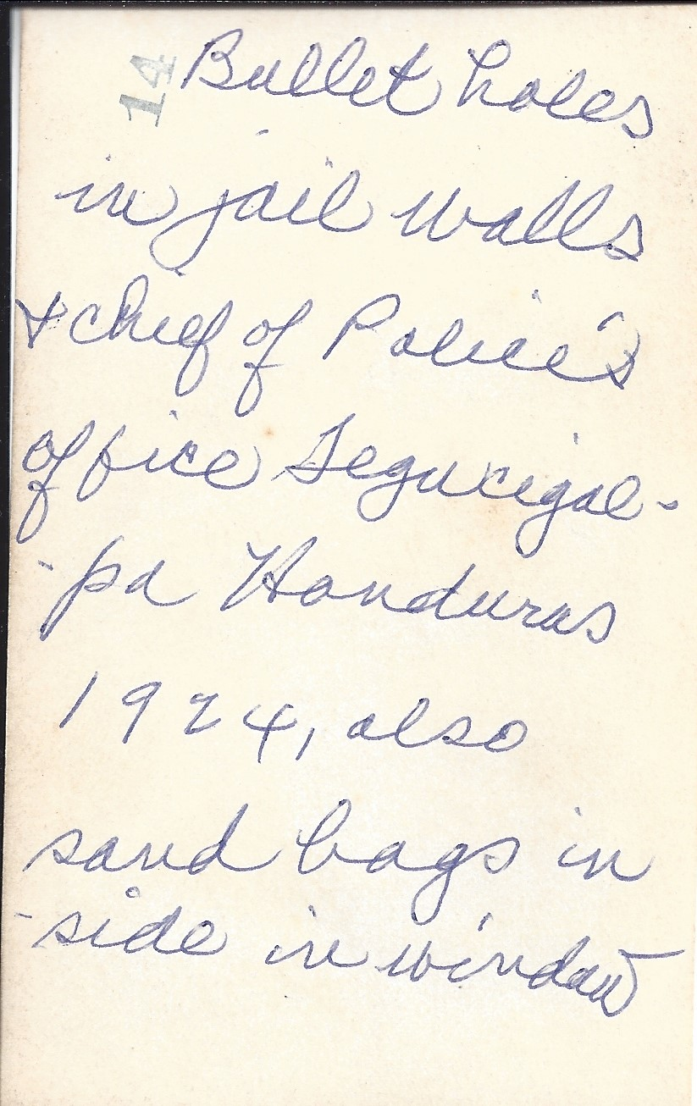
Bullet holes in jail

